Slide 1
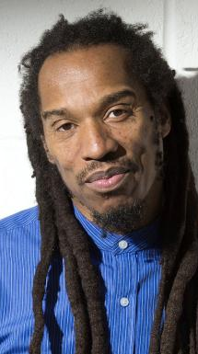
Benjamin
Zephaniah
Who is he?

Slide 2
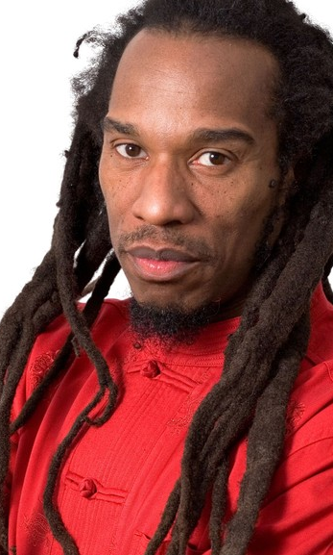
Write a short biography about
Benjamin zephaniah
Who do you think this man is?
Where do you think he lives?
What kind of job do you think he has?
  Work in groups of four
  Answer the questions above
  Answer in full sentences

Slide 3

Plenary discussion
Do your ideas have similarities?
Why do you think this is?

Slide 4
What do people need?
Placemat assignment
Write down your thoughts on this question in your own coloured block
Compare answers to your group members
Shared values will be written in the central block

Slide 5
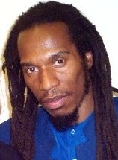
What do we all agree on?
People need…

Slide 6
Reading the poem
Read individually
Underline words you don’t understand

Slide 7
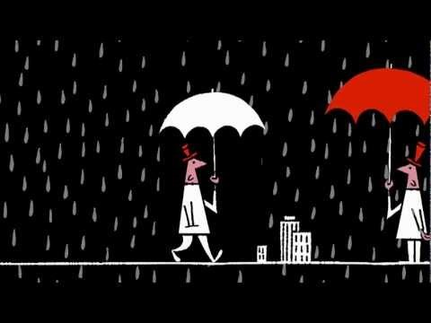
Watch the video
Look at the clip to help you figure out the meaning of difficult words

Slide 8
What does Benjamin say..
People need people…
Why do you need people?

Slide 9

Post reading activity
Choose exercise a or b.
A – Use your top 5 and transfer the most important words into a drawing combined with elements of your own life.
B – Write your own poem of what you think are the most important elements of your own life.
Check the Student package for the criteria.

Slide 10


Next week
Every student will hand in their final assignment
We’ll vote for the best poem/drawing

